Slide 1

Ready for Departure
Full Stack Web GIS Project
Mustafa Selim Issı

Slide 2


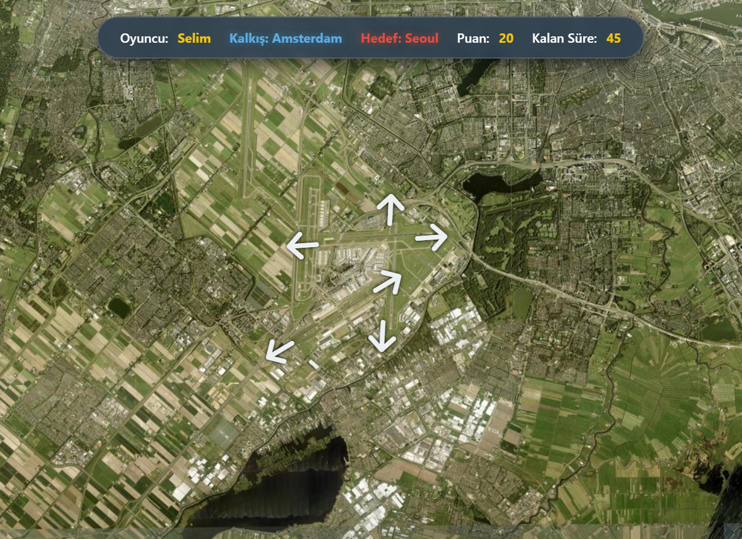

Project Concept: Gamified WebGIS
A web-based simulation where users act as ATC/Pilots to determine correct runway headings using real-world data.
Objective: Navigate to target cities using precise WGS84 coordinates.
Mechanics: Calculate bearing angles on a global map interface.
Core Tech: Utilizes Turf.js for Geodesic (Great Circle) calculations.
Focus: Engineering accuracy over arcade-style physics.

Slide 3






Cloud-Native Architecture
Compute & OS
Data Persistence
Application Layer
AWS EC2 (Stockholm Region)
MongoDB Atlas (NoSQL)
Node.js & Express Backend
Ubuntu Linux Environment
Flexible JSON Structure
Leaflet.js Frontend Map
PM2 Process Manager
Cloud-hosted Scalability
RESTful API Design

Slide 4







Features & Security
User Roles
Security Protocols
Quick play, no DB record.
JWT Auth: JSON Web Tokens for secure, stateless session management.
Saves scores & tracks progress.
Bcrypt: Industry-standard hashing algorithms for password encryption.
Debug mode & system oversight.
Helmet.js: Middleware for securing HTTP headers.

Slide 5



Engineering Validation
600
70ms
0%
Requests / Min
Average Latency
Error Rate
LOAD CAPACITY
RESPONSE TIME
RELIABILITY
Performance metrics verified using Artillery.io load testing framework.

Slide 6



Thank You!
Q&A Session
http://56.228.7.59:3000
Live Demo Available

